Slide 1
Lecture 17, Still lesson 10: mechanical waves
Teacher: Dr. Paul Briard
Notes:
PARLER LENTEMENT: Sorry for the disagreement to teach you online. I wish it will be possible to have lecture in classroom next week. The actual situation is not a so bad news for you because your middle-term examination has been postponed to next week, so if I was you, I would profit to this time to practice physics. Let’s continue the lecture about mechanical waves.

Slide 2
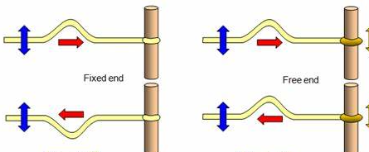
Summary about the reflection
http://www.schoolphysics.co.uk/age16-19/Wave%20properties/Wave%20properties/text/Phase_change/index.html
Fixed end: the incident wave and the reflected waves (here pulses) are inverted to each other
Free end: the incident wave and the reflected waves (here pulses) are not inverted to each other
Notes:
PARLER LENTEMENT: Here is a summary of what we have seen about what we have seen about the reflection of a wave at a free end and at a fixed end. The shape of the reflected wave is the same than the shape of the wave incident on the end. But for the case of the fixed end, both waves are inverted to each other. For the case of the free end, both waves are not inverted to each other.

Slide 3
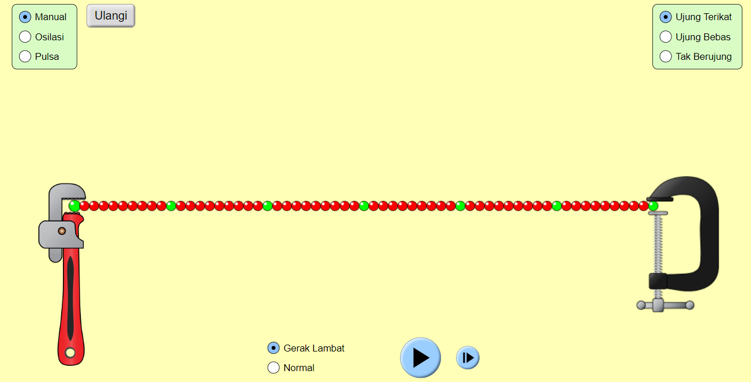
Reflection of a wave at a fixed end
Website: https://phet.colorado.edu/sims/html/wave-on-a-string/latest/wave-on-a-string_in.html
Choose
manual to “draw” the wave by moving the tool upward or downward
ujung terikat (at top right) for fixed end
Ulangi: string at equilibrium.
Notes:
PARLER LENTEMENT: Here is a quite interesting software to watch what happens when the end is free or fixed. In this example, the end is a fixed end, and we can move the tool at the right upward or downward. OUVRIR LA PAGE WEB POUR MONTRER.

Slide 4
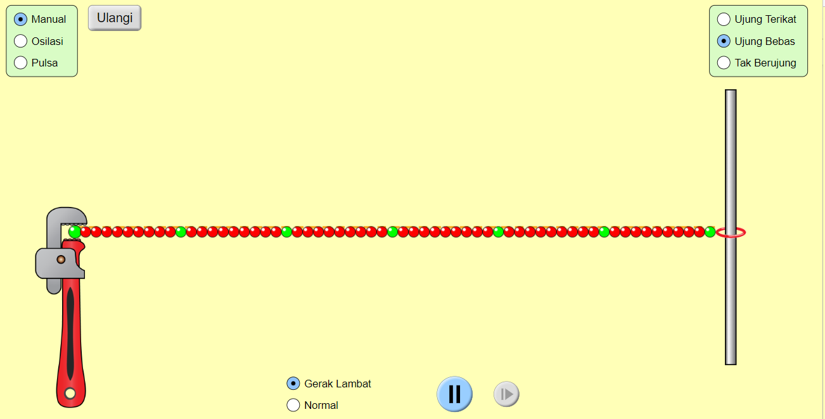
Reflection of a wave at a fixed end
Ujung Bebas (at top right) for free end
Notes:
PARLER LENTEMENT:

Slide 5
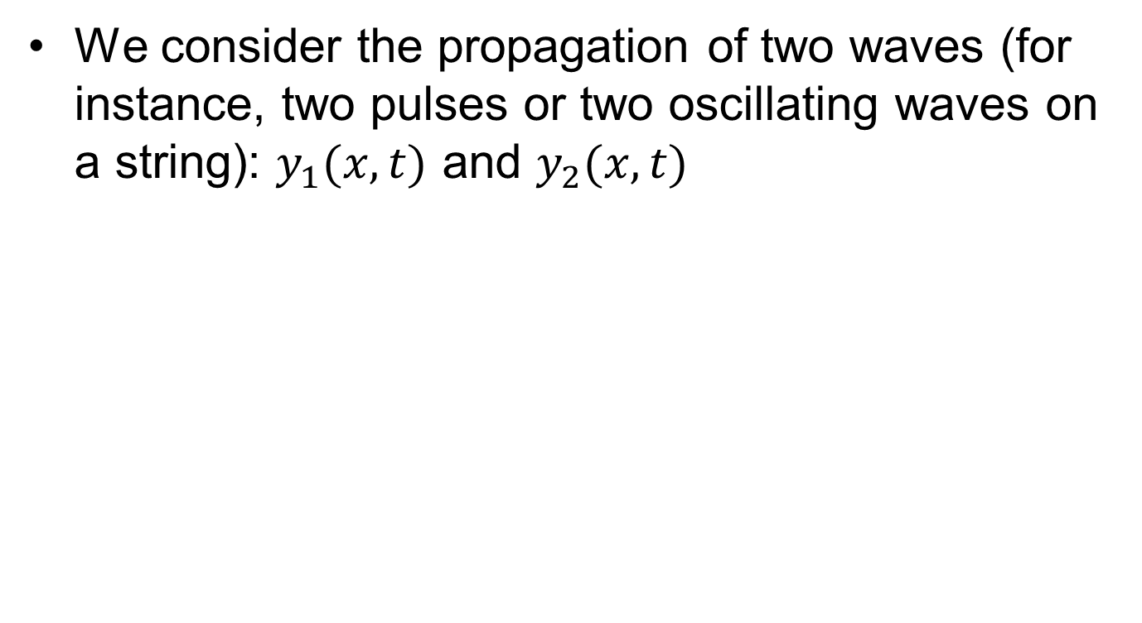
Principle of superposition of waves
We consider the propagation of two waves (for instance, two pulses or two oscillating waves on a string): $y_{1}(x,t)$ and $y_{2}(x,t)$
Notes:
PARLER LENTEMENT: To describe the standing waves, we will consider the superposition of two waves. It is similar to the superposition of two waves in the interference phenomenon we have described last time. The standing waves and interference are both involved with superposition of waves. But take care that they don’t have the same meaning. You have always interferences between waves of same frequency which overlap at same point of space, but there are particular conditions to observe standing waves, so we could have interference between waves without to have standing wave.. We describe a wave here as the displacement along the y-axis, upward or downward, The wave propagates toward the right or the left, along the x-axis. Two waves on the string are described by these functions.

Slide 6
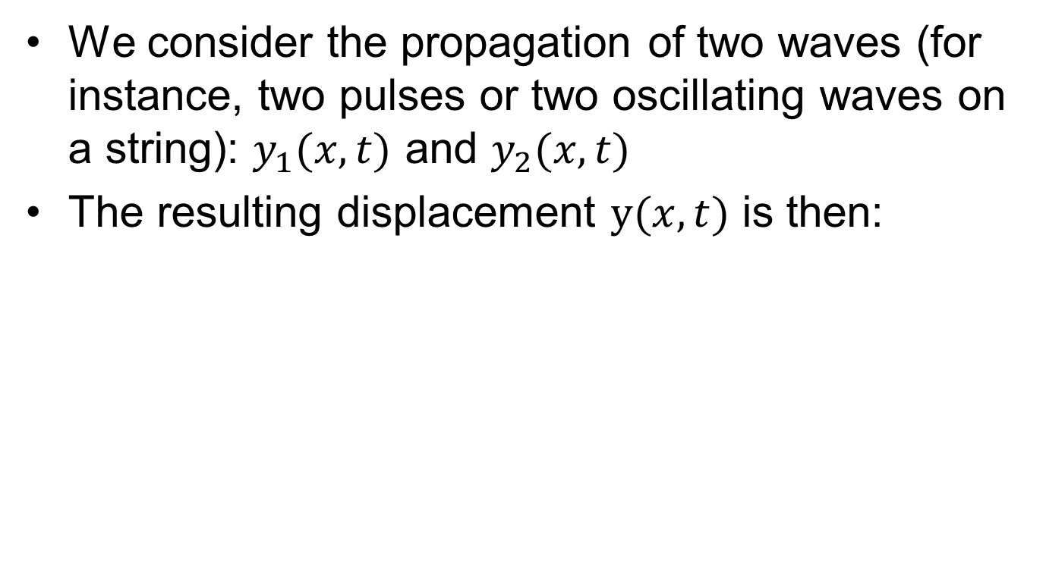
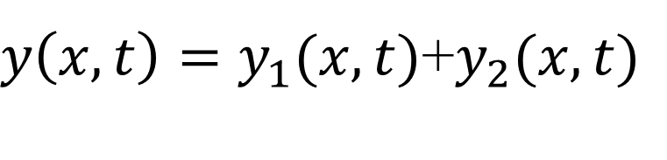
Principle of superposition of waves
We consider the propagation of two waves (for instance, two pulses or two oscillating waves on a string): $y_{1}(x,t)$ and $y_{2}(x,t)$
The resulting displacement $y(x,t)$ is then:
$y\left(x,t\right)=y_{1}(x,t)$+$y_{2}(x,t)$
Notes:
PARLER LENTEMENT: The resulting displacement is simply the sum of each displacement corresponding to each wave.

Slide 7
Principle of superposition of waves
We consider the propagation of two waves (for instance, two pulses or two oscillating waves on a string): $y_{1}(x,t)$ and $y_{2}(x,t)$
The resulting displacement $y(x,t)$ is then:
$y\left(x,t\right)=y_{1}(x,t)$+$y_{2}(x,t)$
This principle is called “principle of superposition” or “principle of linear superposition”.
Notes:
PARLER LENTEMENT: This principle is called “principle of superposition” or “principle of linear superposition”. We say linear superposition, because not all phenomena in physics have such linear properties.

Slide 8
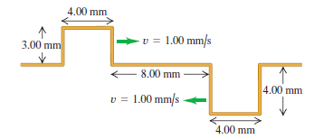
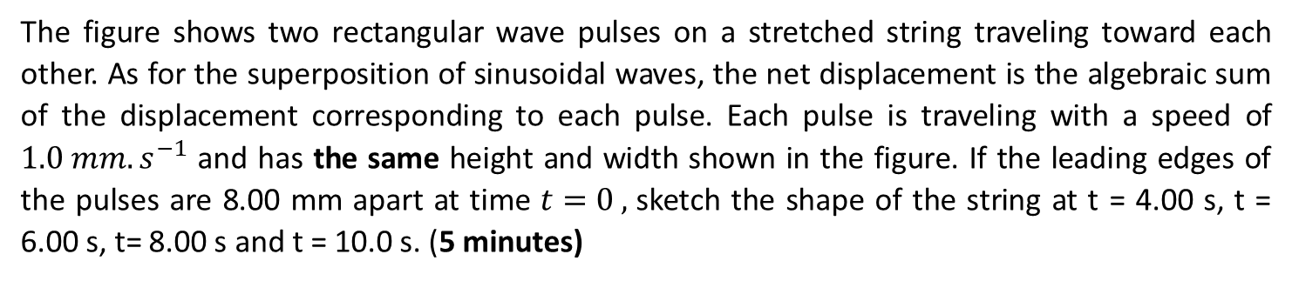
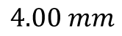
Superposition between two pulses counter-propagating.
The figure shows two rectangular wave pulses on a stretched string traveling toward each other. As for the superposition of sinusoidal waves, the net displacement is the algebraic sum of the displacement corresponding to each pulse. Each pulse is traveling with a speed of $1.0 mm.s^{−1}$ and has the same height and width shown in the figure. If the leading edges of the pulses are 8.00 mm apart at time $t=0 ,$sketch the shape of the string at t = 4.00 s, t = 6.00 s, t= 8.00 s and t = 10.0 s. (5 minutes)
$$4.00 mm$$
Notes:
PARLER LENTEMENT. What happens if two waves inverted to each other counter-propagates toward opposite directions. Here two rectangular wave pulses on a stretched string traveling toward each other. As for the superposition of sinusoidal waves, the net displacement is the algebraic sum of the displacement corresponding to each pulse. Each pulse is traveling with a speed of $1.0 mm.s^{−1}$ and has the shape shown in the figure. Please to sketch the shape of the string after the time given in the exercise, The velocity of propagation is the same, 1 mm per second. The rectangular shape is chosen because it is more easy to describe their resultant.

Slide 9
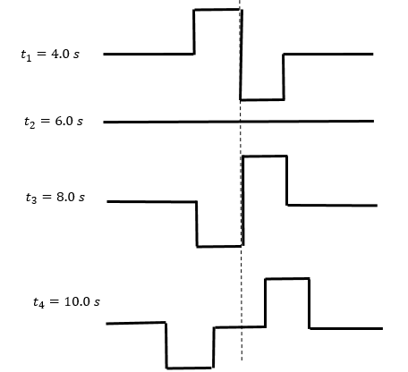
Superposition between two pulses counter-propagating.
Notes:
PARLER LENTEMENT: At time t = 4 second, the pulse reach each other.

Slide 10
Superposition between two pulses counter-propagating.
Notes:
PARLER LENTEMENT: Then the rope is at equilibrium position.

Slide 11
Superposition between two pulses counter-propagating.
Notes:
PARLER LENTEMENT: Then, we obtain a figure similar with the shape of the rope at t = 4 seconds. After 8 s, the both pulses don’t overlap together.

Slide 12
Superposition between two pulses counter-propagating.
Notes:
PARLER LENTEMENT: As you can see at 10 seconds,

Slide 13
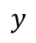
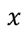
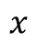
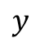
Reflection of a sinusoidal wave in case of a fixed end
$$y$$
O
$$x$$
Incident wave propagating to the right (toward the +$x$-direction)
$$y$$
O
$$x$$
Reflected wave propagating to the left (toward the $−x$-direction)
Notes:
PARLER LENTEMENT: Instead of pulses, we consider now sinusoidal waves. We have described sinusoidal waves last time. A sinusoidal wave can propagate on the string. If the oscillator at the end which produce the wave has sinusoidal oscillation, the wave propagates toward the right is sinusoidal. Then the wave is reflected toward the left. The reflected wave is also sinusoidal, have same amplitude and frequency, but propagates toward the left. What happens when both waves propagates on the string. Let’s see with the previous software.

Slide 14
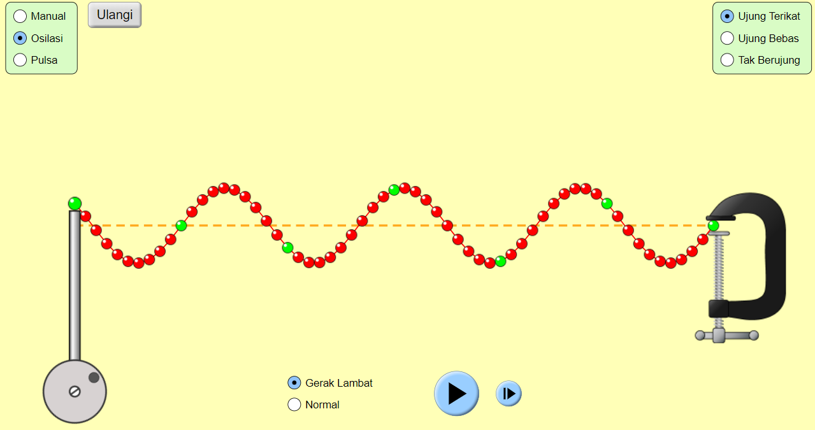
Let’s see what happens when a sinusoidal wave is reflected
Website: https://phet.colorado.edu/sims/html/wave-on-a-string/latest/wave-on-a-string_in.html
Choose Osilasi for sinusoidal wave and for instance amplitude: 0.44 cm,
frequency; 3.00 Hz
Notes:
PARLER LENTEMENT:

Slide 15
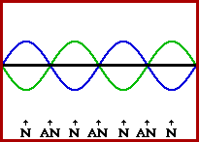
Standing waves
Example of two waves propagating in two opposite direction at the same angular frequency:
https://www.physicsclassroom.com/mmedia/waves/swf.gif
The blue and the green curves are the incident and the reflected wave. The black curve is the interference between the incident and the reflected wave
15
Notes:
PARLER LENTEMENT: And here you see an example of two waves counter-propagating. The blue wave propagates toward the right. The green wave propagates toward the left. The resulting wave is the black curve, What you see is similar to what you have seen with the previous software, but in this example both ends are free end. Let’s see the black curve which show a standing wave. You can see particular points corresponding to maximum amplitude of the oscillation, written AN on the figure, These points are named “antinodes” of the standing wave. As you can see, there are particular times where the resulting wave corresponds to equilibrium, the black curve is at horizontal, but there are particular points written which are always at equilibrium. These points are named the “nodes” of the standing waves,

Slide 16
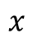
Standing waves
Example of two waves propagating in two opposite direction at the same angular frequency:
https://www.physicsclassroom.com/mmedia/waves/swf.gif
The blue and the green curves are the incident and the reflected wave. The black curve is the interference between the incident and the reflected wave
It can for instance a standing wave on a string where the incident wave is reflected on a free end.
Reflected wave
$$x$$
16
Incident wave
Notes:
PARLER LENTEMENT: This figure could represent what happens with a string with fixed ends. But as we have seen together, there could be standing waves for both kinds of cases, fixed end and free end.

Slide 17
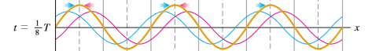
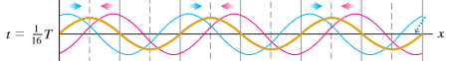

Standing waves
Another example:
$$λ$$
Equilibrium position
Notes:
PARLER LENTEMENT: Here is another example. The blue wave propagates toward the right. The pink wave propagates toward the left. The orange curve is the resulting wave. This figure could describe for instance a string which has the shape of the orange curve. Both waves are sinusoidal and have wavelength lambda. If there is no wave propagating the string is at horizontal, along the x-axis, which correspond to an equilibrium position. Both wave have a period T. At t = 0, the string is at equilibrium, At t = the period divided by sixteen, the string is as you see with the orange curve.

Slide 18
Standing waves
Another example.
Notes:
PARLER LENTEMENT: A bit later, at time t = the period divided by eight, the string is has you see with the orange curve. The maximum between both waves become closer …

Slide 19
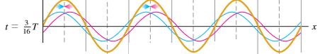
Standing waves
Another example.
Notes:
PARLER LENTEMENT: And closer, until …

Slide 20
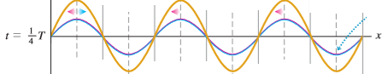
Standing waves
Another example:
The transverse displacement is maximum
Coincidence between the incident wave and the refracted wave
Notes:
PARLER LENTEMENT: Until the maxima of both waves are at same x-coordinates. In that case, there is coincidence between the incident wave and the reflected wave, The displacement of the resulting standing wave is maximum. You can notice that this happens at the time t equals one quarter of the period T.

Slide 21
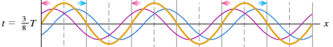
Standing waves
Another example:
Notes:
PARLER LENTEMENT: Then the amplitude of the resulting wave decrease …

Slide 22
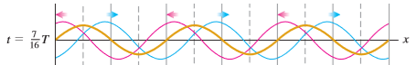
Standing waves
Another example:
Notes:
PARLER LENTEMENT: And decrease ….

Slide 23
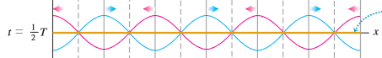
Standing waves
Another example:
The string is at equilibrium position
Notes:
PARLER LENTEMENT: Until the string is at equilibrium position, The maxima of the incident wave have same x-coordinate then the minima of the reflected wave. You can notice that this happens at the time t equals to the half of the period.

Slide 24
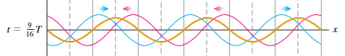
Standing waves
Another example.
Notes:
PARLER LENTEMENT: And

Slide 25
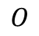
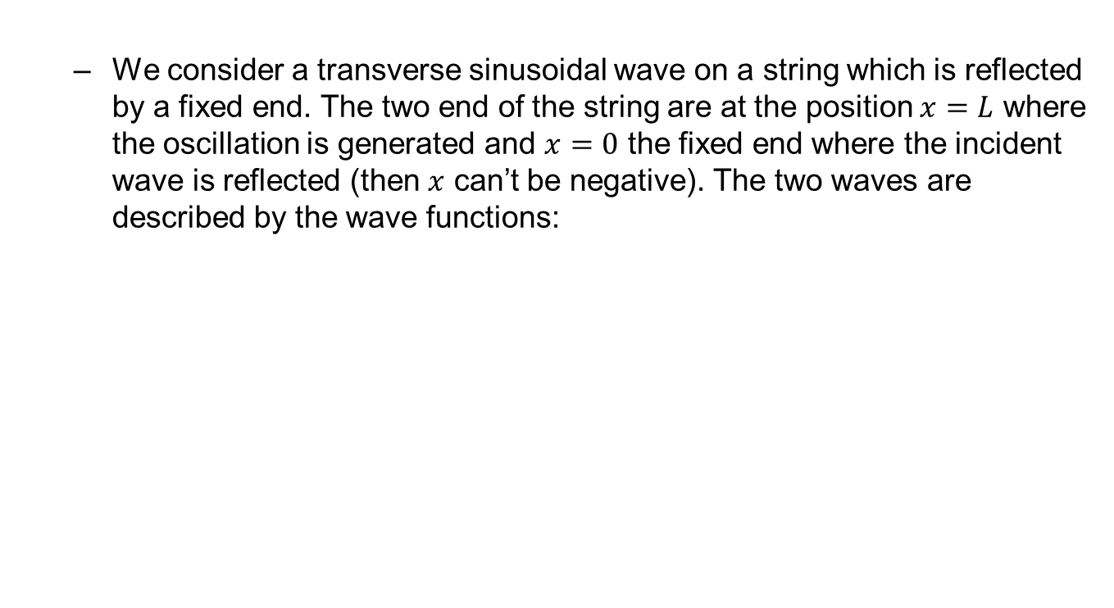
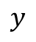
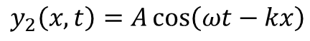
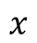
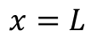
Ex. Standing waves
We consider a transverse sinusoidal wave on a string which is reflected by a fixed end. The two end of the string are at the position $x=L$ where the oscillation is generated and $x=0$ the fixed end where the incident wave is reflected (then $x$ can’t be negative). The two waves are described by the wave functions:
$$y_{1}\left(x,t\right)=−A\cos\left(ωt+kx\right)=A\cos\left(ωt+kx+π\right)$$
$$y_{2}\left(x,t\right)=A\cos\left(ωt−kx\right)$$
$$y$$
N
N
$$O$$
$$x$$
N (Node of the standing wave)
$$x=L$$
Notes:
PARLER LENTEMENT: So here is a little exercise to describe standing waves. The y-displacement of both counter-propagating waves are described. There is a string between point O at x = 0 and the end of the string at x = L. A sinusoidal wave which propagates toward the left is reflected at the fixed end at x = 0. This wave is describe by y_1. The reflected wave, described by y_2 is propagating toward the right. The origin of time is chosen such as the phase at origin of the reflected wave, propagating toward the right is zero. As you can see on the equation for y_1, the phase at origin of the incident wave is pi. Both wave don’t have the same phase at origin. The black curve on the graph describe the resulting standing wave, where the points N are the nodes of the standing wave.

Slide 26
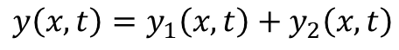
Ex. Standing waves
We consider a transverse sinusoidal wave on a string which is reflected by a fixed end. The two end of the string are at the position $x=L$ where the oscillation is generated and $x=0$ the fixed end where the incident wave is reflected (then $x$ can’t be negative). The two waves are described by the wave functions:
$$y_{1}\left(x,t\right)=−A\cos\left(ωt+kx\right)=A\cos\left(ωt+kx+π\right)$$
$$y_{2}\left(x,t\right)=A\cos\left(ωt−kx\right)$$
The interference between the incident waves and the reflected wave gives the transverse displacement :
$$y\left(x,t\right)=y_{1}\left(x,t\right)+y_{2}\left(x,t\right)$$
$$y$$
N
N
$$O$$
$$x$$
N (Node of the standing wave)
$$x=L$$
Notes:
PARLER LENTEMENT: The superposition between both waves is described as follows. There are interference because both waves propagates at same angular frequency.

Slide 27
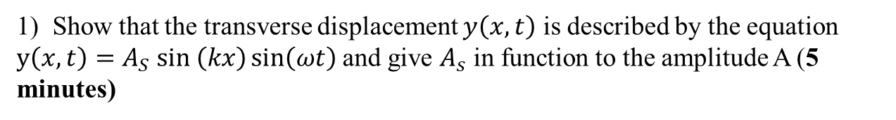
Ex. Standing waves
We consider a transverse sinusoidal wave on a string which is reflected by a fixed end. The two end of the string are at the position $x=L$ where the oscillation is generated and $x=0$ the fixed end where the incident wave is reflected (then $x$ can’t be negative). The two waves are described by the wave functions:
$$y_{1}\left(x,t\right)=−A\cos\left(ωt+kx\right)=A\cos\left(ωt+kx+π\right)$$
$$y_{2}\left(x,t\right)=A\cos\left(ωt−kx\right)$$
The interference between the incident waves and the reflected wave gives the transverse displacement :
$$y\left(x,t\right)=y_{1}\left(x,t\right)+y_{2}\left(x,t\right)$$
1) Show that the transverse displacement $y\left(x,t\right)$ is described by the equation $y\left(x,t\right)=A_{S} sin \left(kx\right)\sin\left(ωt\right)$ and give $A_{s}$ in function to the amplitude A (5 minutes)
$$y$$
N
N
$$O$$
$$x$$
N (Node of the standing wave)
$$x=L$$
Notes:
PARLER LENTEMENT: First, please to show that the resulting transverse displacement is decribed as follows. Where the amplitude A_s of the standing wave has to be described in terms of the amplitude of A, which is the same for both incident and reflected wave.

Slide 28
Ex. Standing waves
We consider a transverse sinusoidal wave on a string which is reflected by a fixed end. The two end of the string are at the position $x=L$ where the oscillation is generated and $x=0$ the fixed end where the incident wave is reflected (then $x$ can’t be negative). The two waves are described by the wave functions:
$$y_{1}\left(x,t\right)=−A\cos\left(ωt+kx\right)=A\cos\left(ωt+kx+π\right)$$
$$y_{2}\left(x,t\right)=A\cos\left(ωt−kx\right)$$
The interference between the incident waves and the reflected wave gives the transverse displacement :
$$y\left(x,t\right)=y_{1}\left(x,t\right)+y_{2}\left(x,t\right)$$
1) Show that the transverse displacement $y\left(x,t\right)$ is described by the equation $y\left(x,t\right)=A_{S} sin \left(kx\right)\sin\left(ωt\right)$ and give $A_{s}$ in function to the amplitude A (5 minutes)
$$\cos\left(θ_{1}+θ_{2}\right)=\cos{θ_{1}\cos{θ_{2}}−\sin{θ_{1}\sin{θ_{2}}}}$$
$$\cos\left(θ_{1}−θ_{2}\right)=\cos{θ_{1}\cos{θ_{2}}+\sin{θ_{1}\sin{θ_{2}}}}$$
$$y$$
N
N
$$O$$
$$x$$
N (Node of the standing wave)
$$x=L$$
Notes:
PARLER LENTEMENT. Here is the property of the cosine of the sum or difference of two angles, which could be useful to solve this exercise.

Slide 29
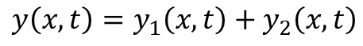
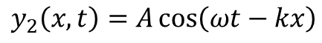
Standing waves
$$y_{1}\left(x,t\right)=−A\cos\left(ωt+kx\right)=A\cos\left(ωt+kx+π\right)$$
$$y_{2}\left(x,t\right)=A\cos\left(ωt−kx\right)$$
$$y\left(x,t\right)=y_{1}\left(x,t\right)+y_{2}\left(x,t\right)$$
1)
$$y\left(x,t\right)=A\left[\cos\left(ωt−kx\right)−\cos\left(ωt+kx\right)\right]$$
Notes:
PARLER LENTEMENT: Here is the solution. First, we have to describe the resulting wave, which is the sum of both displacement corresponding to the incident wave and the reflected wave.

Slide 30
Standing waves
$$y_{1}\left(x,t\right)=−A\cos\left(ωt+kx\right)=A\cos\left(ωt+kx+π\right)$$
$$y_{2}\left(x,t\right)=A\cos\left(ωt−kx\right)$$
$$y\left(x,t\right)=y_{1}\left(x,t\right)+y_{2}\left(x,t\right)$$
1)
$$y\left(x,t\right)=A\left[\cos\left(ωt−kx\right)−\cos\left(ωt+kx\right)\right]$$
$$\cos\left(θ_{1}+θ_{2}\right)=\cos{θ_{1}\cos{θ_{2}}−\sin{θ_{1}\sin{θ_{2}}}}$$
$$\cos\left(θ_{1}−θ_{2}\right)=\cos{θ_{1}\cos{θ_{2}}+\sin{θ_{1}\sin{θ_{2}}}}$$
Notes:
PARLER LENTEMENT: Here is the property of the cosine of the sum or difference between two angles. It is not something you have to demonstrate by yourself to solve this exercise. Later, we will see if we can demonstrate such properties.

Slide 31
Standing waves
$$y_{1}\left(x,t\right)=−A\cos\left(ωt+kx\right)=A\cos\left(ωt+kx+π\right)$$
$$y_{2}\left(x,t\right)=A\cos\left(ωt−kx\right)$$
$$y\left(x,t\right)=y_{1}\left(x,t\right)+y_{2}\left(x,t\right)$$
1)
$$y\left(x,t\right)=A\left[\cos\left(ωt−kx\right)−\cos\left(ωt+kx\right)\right]$$
$$\cos\left(θ_{1}+θ_{2}\right)=\cos{θ_{1}\cos{θ_{2}}−\sin{θ_{1}\sin{θ_{2}}}}$$
$$\cos\left(ωt+kx\right)=\cos\left(ωt\right)\cos\left(kx\right)−\sin\left(ωt\right)\sin\left(kx\right)$$
$$\cos\left(θ_{1}−θ_{2}\right)=\cos{θ_{1}\cos{θ_{2}}+\sin{θ_{1}\sin{θ_{2}}}}$$
$$\cos\left(ωt−kx\right)=\cos\left(ωt\right)\cos\left(kx\right)+\sin\left(ωt\right)\sin\left(kx\right)$$
Notes:
PARLER LENTEMENT: We obtain the following expression between cosine of omega t plus k x, and cosine of omega t minus k x.

Slide 32
Standing waves
$$y_{1}\left(x,t\right)=−A\cos\left(ωt+kx\right)=A\cos\left(ωt+kx+π\right)$$
$$y_{2}\left(x,t\right)=A\cos\left(ωt−kx\right)$$
$$y\left(x,t\right)=y_{1}\left(x,t\right)+y_{2}\left(x,t\right)$$
1)
$$y\left(x,t\right)=A\left[\cos\left(ωt−kx\right)−\cos\left(ωt+kx\right)\right]$$
$$\cos\left(θ_{1}+θ_{2}\right)=\cos{θ_{1}\cos{θ_{2}}−\sin{θ_{1}\sin{θ_{2}}}}$$
$$\cos\left(ωt+kx\right)=\cos\left(ωt\right)\cos\left(kx\right)−\sin\left(ωt\right)\sin\left(kx\right)$$
$$\cos\left(θ_{1}−θ_{2}\right)=\cos{θ_{1}\cos{θ_{2}}+\sin{θ_{1}\sin{θ_{2}}}}$$
$$\cos\left(ωt−kx\right)=\cos\left(ωt\right)\cos\left(kx\right)+\sin\left(ωt\right)\sin\left(kx\right)$$
$$y\left(x,t\right)=A\left[\cos\left(ωt\right)\cos\left(kx\right)+\sin\left(ωt\right)\sin\left(kx\right)−\left(\cos\left(ωt\right)\cos\left(kx\right)−\sin\left(ωt\right)\sin\left(kx\right)\right)\right]$$
Notes:
PARLER LENTEMENT: We put there expression in the resulting transverse displacement y. We obtain a quite complicated equation which can be simplified. You can see that two terms cancel to each other.

Slide 33
Standing waves
$$y_{1}\left(x,t\right)=−A\cos\left(ωt+kx\right)=A\cos\left(ωt+kx+π\right)$$
$$y_{2}\left(x,t\right)=A\cos\left(ωt−kx\right)$$
$$y\left(x,t\right)=y_{1}\left(x,t\right)+y_{2}\left(x,t\right)$$
1)
$$y\left(x,t\right)=A\left[\cos\left(ωt−kx\right)−\cos\left(ωt+kx\right)\right]$$
$$\cos\left(θ_{1}+θ_{2}\right)=\cos{θ_{1}\cos{θ_{2}}−\sin{θ_{1}\sin{θ_{2}}}}$$
$$\cos\left(ωt+kx\right)=\cos\left(ωt\right)\cos\left(kx\right)−\sin\left(ωt\right)\sin\left(kx\right)$$
$$\cos\left(θ_{1}−θ_{2}\right)=\cos{θ_{1}\cos{θ_{2}}+\sin{θ_{1}\sin{θ_{2}}}}$$
$$\cos\left(ωt−kx\right)=\cos\left(ωt\right)\cos\left(kx\right)+\sin\left(ωt\right)\sin\left(kx\right)$$
$$y\left(x,t\right)=A\left[\cos\left(ωt\right)\cos\left(kx\right)+\sin\left(ωt\right)\sin\left(kx\right)−\left(\cos\left(ωt\right)\cos\left(kx\right)−\sin\left(ωt\right)\sin\left(kx\right)\right)\right]$$
$$y\left(x,t\right)=2A\sin\left(ωt\right)\sin\left(kx\right)$$
Notes:
PARLER LENTEMENT: We obtain this expression.

Slide 34
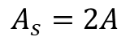
Standing waves
$$y_{1}\left(x,t\right)=−A\cos\left(ωt+kx\right)=A\cos\left(ωt+kx+π\right)$$
$$y_{2}\left(x,t\right)=A\cos\left(ωt−kx\right)$$
$$y\left(x,t\right)=y_{1}\left(x,t\right)+y_{2}\left(x,t\right)$$
1)
$$y\left(x,t\right)=A\left[\cos\left(ωt−kx\right)−\cos\left(ωt+kx\right)\right]$$
$$\cos\left(θ_{1}+θ_{2}\right)=\cos{θ_{1}\cos{θ_{2}}−\sin{θ_{1}\sin{θ_{2}}}}$$
$$\cos\left(ωt+kx\right)=\cos\left(ωt\right)\cos\left(kx\right)−\sin\left(ωt\right)\sin\left(kx\right)$$
$$\cos\left(θ_{1}−θ_{2}\right)=\cos{θ_{1}\cos{θ_{2}}+\sin{θ_{1}\sin{θ_{2}}}}$$
$$\cos\left(ωt−kx\right)=\cos\left(ωt\right)\cos\left(kx\right)+\sin\left(ωt\right)\sin\left(kx\right)$$
$$y\left(x,t\right)=A\left[\cos\left(ωt\right)\cos\left(kx\right)+\sin\left(ωt\right)\sin\left(kx\right)−\left(\cos\left(ωt\right)\cos\left(kx\right)−\sin\left(ωt\right)\sin\left(kx\right)\right)\right]$$
$$y\left(x,t\right)=2A\sin\left(ωt\right)\sin\left(kx\right)$$
$$y\left(x,t\right)=A_{S}\sin\left(ωt\right)\sin\left(kx\right)$$
$$A_{s}=2A$$
Notes:
PARLER LENTEMENT: You can see that the amplitude of the standing wave is twice the amplitude of the incident wave and the reflecting wave.

Slide 35
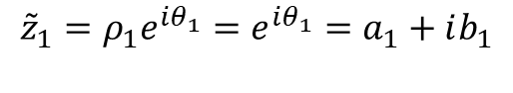
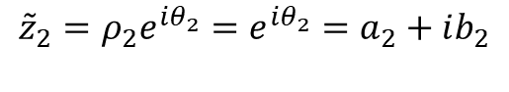
Here is another usefulness of complex numbers
Considering two complex numbers of modulus 1:
$${\tilde{z}}_{1}=ρ_{1}e^{iθ_{1}}=e^{iθ_{1}}=a_{1}+ib_{1}$$
$${\tilde{z}}_{2}=ρ_{2}e^{iθ_{2}}=e^{iθ_{2}}=a_{2}+ib_{2}$$
Notes:
PARLER LENTEMENT: Now, let’s see if can demonstrate the property about the cosine of the sum of two angles. Let’s consider two complex numbers z_1 and z_2. Here we consider complex numbers of modulus equals 1.

Slide 36
Here is another usefulness of complex numbers
Considering two complex numbers of modulus 1:
$${\tilde{z}}_{1}=ρ_{1}e^{iθ_{1}}=e^{iθ_{1}}=a_{1}+ib_{1}$$
$${\tilde{z}}_{2}=ρ_{2}e^{iθ_{2}}=e^{iθ_{2}}=a_{2}+ib_{2}$$
$${\tilde{z}}_{1}{\tilde{z}}_{2}=a_{1}a_{2}−b_{1}b_{2}+i\left(b_{1}a_{2}+a_{1}b_{2}\right)=e^{i(θ_{1}+θ_{2})}$$
Notes:
PARLER LENTEMENT: Lets calculate the product between these complex numbers. You can see that it is also a complex number which the argument is the sum of the argument of the complex numbers z_1 and z_2. So its argument is theta_1 + theta_2. As you can see, we can describe each real part and imaginary part of the product between both complex numbers in terms of their real part a_1 and a_2 and imaginary part b_1 and b_2.

Slide 37
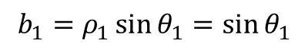
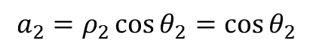
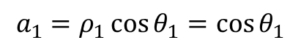
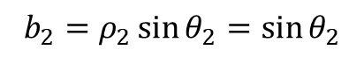
Here is another usefulness of complex numbers
Considering two complex numbers of modulus 1:
$${\tilde{z}}_{1}=ρ_{1}e^{iθ_{1}}=e^{iθ_{1}}=a_{1}+ib_{1}$$
$${\tilde{z}}_{2}=ρ_{2}e^{iθ_{2}}=e^{iθ_{2}}=a_{2}+ib_{2}$$
$${\tilde{z}}_{1}{\tilde{z}}_{2}=a_{1}a_{2}−b_{1}b_{2}+i\left(b_{1}a_{2}+a_{1}b_{2}\right)=e^{i(θ_{1}+θ_{2})}$$
$$a_{1}=ρ_{1}\cos{θ_{1}}=\cos{θ_{1}}$$
$$b_{1}=ρ_{1}\sin{θ_{1}}=\sin{θ_{1}}$$
$$a_{2}=ρ_{2}\cos{θ_{2}}=\cos{θ_{2}}$$
$$b_{2}=ρ_{2}\sin{θ_{2}}=\sin{θ_{2}}$$
Notes:
PARLER LENTEMENT: And we know what are the relation between each real part and imaginary part with their arguments.

Slide 38
Here is another usefulness of complex numbers
Considering two complex numbers of modulus 1:
$${\tilde{z}}_{1}=ρ_{1}e^{iθ_{1}}=e^{iθ_{1}}=a_{1}+ib_{1}$$
$${\tilde{z}}_{2}=ρ_{2}e^{iθ_{2}}=e^{iθ_{2}}=a_{2}+ib_{2}$$
$${\tilde{z}}_{1}{\tilde{z}}_{2}=a_{1}a_{2}−b_{1}b_{2}+i\left(b_{1}a_{2}+a_{1}b_{2}\right)=e^{i(θ_{1}+θ_{2})}$$
$$a_{1}=ρ_{1}\cos{θ_{1}}=\cos{θ_{1}}$$
$$b_{1}=ρ_{1}\sin{θ_{1}}=\sin{θ_{1}}$$
$$a_{2}=ρ_{2}\cos{θ_{2}}=\cos{θ_{2}}$$
$$b_{2}=ρ_{2}\sin{θ_{2}}=\sin{θ_{2}}$$
$$Re\left\{{\tilde{z}}_{1}{\tilde{z}}_{2}\right\}=\cos\left(θ_{1}+θ_{2}\right)=\cos{θ_{1}\cos{θ_{2}}−\sin{θ_{1}\sin{θ_{2}}}}$$
Notes:
PARLER LENTEMENT: The cosine of theta_1 plus theta_2 is the real part of the product between both complex numbers. We have demonstrated the property we wished. Similar way can permit to describe other properties of cosine functions. You can see another example where complex numbers can be useful.

Slide 39
Here is another usefulness of complex numbers
Considering two complex numbers of modulus 1:
$${\tilde{z}}_{1}=ρ_{1}e^{iθ_{1}}=e^{iθ_{1}}=a_{1}+ib_{1}$$
$${\tilde{z}}_{2}=ρ_{2}e^{iθ_{2}}=e^{iθ_{2}}=a_{2}+ib_{2}$$
$${\tilde{z}}_{1}{\tilde{z}}_{2}=a_{1}a_{2}−b_{1}b_{2}+i\left(b_{1}a_{2}+a_{1}b_{2}\right)=e^{i(θ_{1}+θ_{2})}$$
$$a_{1}=ρ_{1}\cos{θ_{1}}=\cos{θ_{1}}$$
$$b_{1}=ρ_{1}\sin{θ_{1}}=\sin{θ_{1}}$$
$$a_{2}=ρ_{2}\cos{θ_{2}}=\cos{θ_{2}}$$
$$b_{2}=ρ_{2}\sin{θ_{2}}=\sin{θ_{2}}$$
$$Re\left\{{\tilde{z}}_{1}{\tilde{z}}_{2}\right\}=\cos\left(θ_{1}+θ_{2}\right)=\cos{θ_{1}\cos{θ_{2}}−\sin{θ_{1}\sin{θ_{2}}}}$$
You don’t need to remember this result or the demonstration, I give it to you for information.
Notes:
PARLER LENTEMENT: This result is just to give you for your information, but you don’t have to remember it. At least if you need it and you forgot it, you know a way to find it easily.

Slide 40
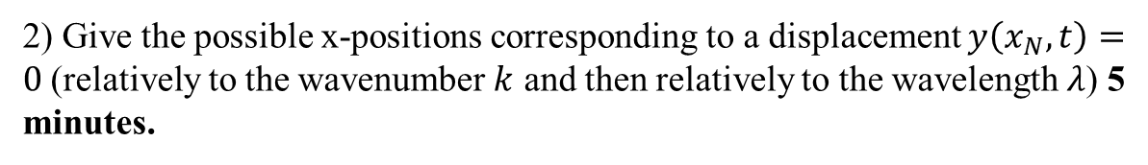
Ex. Standing waves
We consider a transverse sinusoidal wave on a string which is reflected by a fixed end. The two end of the string are at the position $x=L$ where the oscillation is generated and $x=0$ the fixed end where the incident wave is reflected (then $x$ can’t be negative). The two waves are described by the wave functions:
$$y_{1}\left(x,t\right)=−A\cos\left(ωt+kx\right)=A\cos\left(ωt+kx+π\right)$$
$$y_{2}\left(x,t\right)=A\cos\left(ωt−kx\right)$$
The interference between the incident waves and the reflected wave gives the transverse displacement :
$$y\left(x,t\right)=y_{1}\left(x,t\right)+y_{2}\left(x,t\right)$$
1) Show that the transverse displacement $y\left(x,t\right)$ is described by the equation $y\left(x,t\right)=A_{S} sin \left(kx\right)\sin\left(ωt\right)$ and give $A_{s}$ in function to the amplitude A (5 minutes)
2) Give the possible x-positions corresponding to a displacement $y\left(x_{N},t\right)=0$(relatively to the wavenumber $k$ and then relatively to the wavelength $λ$) 5 minutes.
$$y$$
N
N
$$O$$
$$x$$
N (Node of the standing wave)
$$x=L$$
Notes:
PARLER LENTEMENT. Then, please to give the x-coordinates of points corresponding to a transverse displacement equals zero, which means the point corresponding to the nodes of the standing wave. I will choose students for both of these questions,

Slide 41
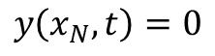
The standing waves
2) Give the possible x-positions of the nodes N corresponding to a displacement $y\left(x_{N},t\right)=0$ relatively to the wavenumber $k$ and then relatively to the wavelength $λ$)
$$y\left(x,t\right)=2A\sin\left(ωt\right)\sin\left(kx\right)$$
$$y\left(x_{N},t\right)=0$$
Notes:
PARLER LENTEMENT: Let’s reply to the second question of the exercise. We want to describe at which coordinates the nodes appear.

Slide 42
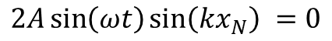
The standing waves
2) Give the possible x-positions of the nodes N corresponding to a displacement $y\left(x_{N},t\right)=0$ relatively to the wavenumber $k$ and then relatively to the wavelength $λ$)
$$y\left(x,t\right)=2A\sin\left(ωt\right)\sin\left(kx\right)$$
$$y\left(x_{N},t\right)=0$$
$$2A\sin\left(ωt\right)\sin\left(kx_{N}\right) =0$$
Notes:
PARLER LENTEMENT: So we have to use the expression of the standing wave. You can see that it is equal to zero for particular positions on the string.

Slide 43
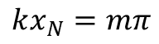
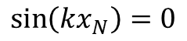
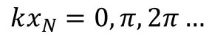
The standing waves
2) Give the possible x-positions of the nodes N corresponding to a displacement $y\left(x_{N},t\right)=0$ relatively to the wavenumber $k$ and then relatively to the wavelength $λ$)
$$y\left(x,t\right)=2A\sin\left(ωt\right)\sin\left(kx\right)$$
$$y\left(x_{N},t\right)=0$$
$$2A\sin\left(ωt\right)\sin\left(kx_{N}\right) =0$$
$$\sin\left(kx_{N}\right)=0$$
$$kx_{N}=mπ$$
$$kx_{N}=0,π,2π…$$
Where m is an integer positive or equal to zero
Notes:
PARLER LENTEMENT: There is a node on the string if the sine of kx = 0. These gives particular values of the x-coordinate. This happens when the angle kx is equals 0, or pi, or 2 pi and so on. So I introduce here the interger m which could be positive or equals zero, in that equation. Take care that for the case of the exercise, the x-coordinate cannot be negative, so integer m cannot be negative.

Slide 44
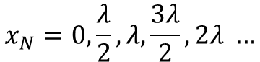
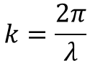

The standing waves
2) Give the possible x-positions of the nodes N corresponding to a displacement $y\left(x_{N},t\right)=0$ relatively to the wavenumber $k$ and then relatively to the wavelength $λ$)
$$y\left(x,t\right)=2A\sin\left(ωt\right)\sin\left(kx\right)$$
$$y\left(x_{N},t\right)=0$$
$$2A\sin\left(ωt\right)\sin\left(kx_{N}\right) =0$$
$$\sin\left(kx_{N}\right)=0$$
$$kx_{N}=mπ$$
$$kx_{N}=0,π,2π…$$
Where m is an integer positive or equal to zero
$$x_{N}=\frac{mπ}{k}=\frac{m}{2}λ$$
using
$$k=\frac{2π}{λ}$$
$$x_{N}=0,\frac{λ}{2},λ,\frac{3λ}{2}, 2λ …$$
Notes:
PARLER LENTEMENT: we obtain two kinds of expression of the x-coordinates of the nodes, in term of the wave number and in terms of the wavelength, You can see that there is nodes at particular values corresponding to half of the wavelength, or the wavelength, 3 times the wavelength and so on. There is also a node at x equals 0 because in the case of the exercise, x equals zero correspond to a fixed end.

Slide 45









The standing waves
2) Give the possible x-positions of the nodes N corresponding to a displacement $y\left(x_{N},t\right)=0$ relatively to the wavenumber $k$ and then relatively to the wavelength $λ$)
$$y\left(x,t\right)=2A\sin\left(ωt\right)\sin\left(kx\right)$$
$$y\left(x_{N},t\right)=0$$
$$2A\sin\left(ωt\right)\sin\left(kx_{N}\right) =0$$
$$\sin\left(kx_{N}\right)=0$$
$$kx_{N}=mπ$$
$$kx_{N}=0,π,2π…$$
Where m is an integer positive or equal to zero
$$x_{N}=\frac{mπ}{k}=\frac{m}{2}λ$$
using
$$k=\frac{2π}{λ}$$
$$x_{N}=0,\frac{λ}{2},λ,\frac{3λ}{2}, 2λ …$$
(the integer $m$ can’t be negative because here $0≤x≤L$($x$ can’t be negative) and the wave number $k=\frac{2π}{λ}$ is positive)
Notes:
PARLER LENTEMENT: Here I just summary to take care that m cannot be negative, because the x-coordinate has to be positive,

Slide 46







Ex. Standing waves
$$y_{1}\left(x,t\right)=−A\cos\left(ωt+kx\right)=A\cos\left(ωt+kx+π\right)$$
$$y_{2}\left(x,t\right)=A\cos\left(ωt−kx\right)$$
The interference between the incident waves and the reflected wave gives the transverse displacement :
$$y\left(x,t\right)=y_{1}\left(x,t\right)+y_{2}\left(x,t\right)$$
3) We consider that for the both end of the string, there is a node, i.e. $y\left(x=0,t\right)=0$ and $y\left(x=L,t\right)=0$. Give a condition on the length L of the string relatively to the wavelength $λ$. (5 minutes)
$$y$$
$$O$$
$$x$$
$$x=L$$
Notes:
PARLER LENTEMENT: Here is a last question about the exercise. We consider that at both end of the string there is a fixed end, which means x = L is also a point where there is a node. Give a condition about the length L of the string in terms of wavelength.

Slide 47


Ex. Standing waves
3) We consider that for the both end of the string, there is a node, i.e. $y\left(x=0,t\right)=0$ and $y\left(x=L,t\right)=0$. Give a condition on the length L of the string relatively to the wavelength $λ$.
$$x_{N}=\frac{mπ}{k}=\frac{m}{2}λ$$
Notes:
PARLER LENTEMENT: First, we know the condition about the x-coordinate of a node.

Slide 48




Ex. Standing waves
3) We consider that for the both end of the string, there is a node, i.e. $y\left(x=0,t\right)=0$ and $y\left(x=L,t\right)=0$. Give a condition on the length L of the string relatively to the wavelength $λ$.
$$x_{N}=\frac{mπ}{k}=\frac{m}{2}λ$$
$$x_{N}=0,\frac{λ}{2},λ,\frac{3λ}{2}, 2λ …$$
Node at
$$x=0$$
Notes:
PARLER LENTEMENT: We obtain different values for the x-coordinate of the nodes.

Slide 49

Ex. Standing waves
3) We consider that for the both end of the string, there is a node, i.e. $y\left(x=0,t\right)=0$ and $y\left(x=L,t\right)=0$. Give a condition on the length L of the string relatively to the wavelength $λ$.
$$x_{N}=\frac{mπ}{k}=\frac{m}{2}λ$$
$$x_{N}=0,\frac{λ}{2},λ,\frac{3λ}{2}, 2λ …$$
$$L=\frac{λ}{2},λ,\frac{3λ}{2}, 2λ …$$
Node at
$$x=0$$
Notes:
PARLER LENTEMENT: Which permit to describe a condition of the Length of the string between both end. Take care that about the case of x = 0, which correspond also to a node, we cannot use it in the condition of the length of the string, because the string should have a certain length.

Slide 50


Ex. Standing waves
3) We consider that for the both end of the string, there is a node, i.e. $y\left(x=0,t\right)=0$ and $y\left(x=L,t\right)=0$. Give a condition on the length L of the string relatively to the wavelength $λ$.
$$x_{N}=\frac{mπ}{k}=\frac{m}{2}λ$$
$$x_{N}=0,\frac{λ}{2},λ,\frac{3λ}{2}, 2λ …$$
$$L=\frac{λ}{2},λ,\frac{3λ}{2}, 2λ …$$
$$L=n\frac{λ}{2}$$
Node at
$$x=0$$
Where $n$ is a positive integer
Notes:
PARLER LENTEMENT: We obtain this condition for the length of the string where n is a positive integer. n cannot be negative because the length cannot be negative, and the wavelength is a positive number.

Slide 51









Ex. Standing waves
3) We consider that for the both end of the string, there is a node, i.e. $y\left(x=0,t\right)=0$ and $y\left(x=L,t\right)=0$. Give a condition on the length L of the string relatively to the wavelength $λ$.
$$x_{N}=\frac{mπ}{k}=\frac{m}{2}λ$$
$$x_{N}=0,\frac{λ}{2},λ,\frac{3λ}{2}, 2λ …$$
$$L=\frac{λ}{2},λ,\frac{3λ}{2}, 2λ …$$
$$L=n\frac{λ}{2}$$
Node at
$$x=0$$
Where $n$ is a positive integer
$$m=0$$
$$m=1$$
$$m=2$$
$$m=3$$
$$m=n=4$$
$$y$$
Example for $L=2λ$
$$O$$
$$x$$
$$x=L=2λ$$
$$λ$$
$$2λ$$
Notes:
PARLER LENTEMENT: So here, you have an example of length L equals to twice the wavelength lambda. You can see that in that case, we observe 5 nodes. The number of nodes depends on the length of the string and if the ends are fixed end or free end, What if the length string don’t fulfill the condition we have described ? In that case, there will be incident and reflected waves which superpose but the resulting wave will be not a standing wave.

Slide 52
Rest time

Slide 53






Standing waves
A standing wave can be created by the superposition of two waves travelling on two opposite directions at the same angular frequency $ω$.
The string at different times. Excepted at the nodes, each point of string has a simple harmonic motion
AN
$$y$$
$$O$$
$$x$$
$$x=L$$
N
N
N
N
$$N$$
Notes:
PARLER LENTEMENT: Here is a summary bout standing waves. On the figure, you see the standing wave at different times, where appears nodes and antinodes. The string at different times. Excepted at the nodes, each point of string has a simple harmonic motion because the incident wave and reflected wave are sinusoidal waves. A standing wave can be created by the superposition of two waves travelling on two opposite directions at the same angular frequency $ω$.

Slide 54

Standing waves
A standing wave can be created by the superposition of two waves travelling on two opposite directions at the same angular frequency $ω$.
The positions of destructive interference between the two waves are named nodes
The string at different times. Excepted at the nodes, each point of string has a simple harmonic motion
AN
$$y$$
$$O$$
$$x$$
$$x=L$$
N
N
N
N
$$N$$
Notes:
PARLER LENTEMENT: The positions of destructive interference between the incident waves and the reflected waves are named nodes

Slide 55

Standing waves
A standing wave can be created by the superposition of two waves travelling on two opposite directions at the same angular frequency $ω$.
The positions of destructive interference between the two waves are named nodes
The position of constructive interference between the two waves are named antinodes (where the amplitude of motion is the greatest).
The string at different times. Excepted at the nodes, each point of string has a simple harmonic motion
AN
$$y$$
$$O$$
$$x$$
$$x=L$$
N
N
N
N
$$N$$
Notes:
PARLER LENTEMENT: The position of constructive interference between the two waves are named antinodes (where the amplitude of motion is the greatest). Take care that there could be interferences between waves even if there is no standing waves, so “interference” and “standing wave” don’t have the same meaning.

Slide 56
Standing waves
A standing wave on a string don’t move along the string (unlike a travelling wave).
The string at different times. Excepted at the nodes, each point of string has a simple harmonic motion
AN
$$y$$
$$O$$
$$x$$
$$x=L$$
N
N
N
56
$$N$$
Notes:
PARLER LENTEMENT: As you have seen and as it is noticed by its name, a standing wave on a string don’t move along the string (unlike a travelling wave).

Slide 57
Standing waves
A standing wave on a string don’t move along the string (unlike a travelling wave).
Unlike for a travelling wave, the energy is not transferred from one end to the other end in a standing wave (the average rate of energy transfer is zero at every point)
The string at different times. Excepted at the nodes, each point of string has a simple harmonic motion
AN
$$y$$
$$O$$
$$x$$
$$x=L$$
N
N
N
57
$$N$$
Notes:
PARLER LENTEMENT: Unlike for a travelling wave, the energy is not transferred from one end to the other end in a standing wave. The average rate of energy transfer is zero at every point. Later we will see how propagate the energy in a traveling wave.

Slide 58

Vibrations on a string
Each strings has two fixed end
The sound produced by a string depends to the tension (the string is tuned with the help of a tuning fork)
https://www.ghmusic.com.au/orchestral/violin-strings
Notes:
PARLER LENTEMENT: The string on an instrument produce standing wave between two end of the string. Of course, there is friction thus there is damping of the oscillations at the string, but you can have standing waves even if there is damping. In that case the amplitude of the oscillation of each point of the string will decreases with the time.

Slide 59






Vibration modes on a string
The four first modes of vibration (of standing wave) of the string:
$$λ/2$$
$$y$$
This mode is the fundamental mode
$$O$$
$$x$$
$$x=L=\frac{λ}{2}$$
$$λ=2L$$
Notes:
PARLER LENTEMENT: Here I show you the four first vibration modes on a string. Both ends are fixed ends. The first mode correspond to the a length equal the half of the wavelength. Or the wavelength is equal to twice the length. This mode is the fundamental mode. You can see that there are only two nodes at the ends of the string and one anti-node at the middle of the string.

Slide 60





Vibration modes on a string
The four first modes of vibration (of standing wave) of the string:
$$λ/2$$
$$y$$
This mode is the fundamental mode
$$O$$
$$x$$
$$x=L=\frac{λ}{2}$$
$$λ=2L$$
$$λ$$
$$y$$
$$O$$
$$x$$
$$x=L=λ$$
Notes:
PARLER LENTEMENT: In the next mode of vibration, the Length is equal to the wavelength. There are three nodes and two antinodes.

Slide 61





Vibration modes on a string
The four first modes of vibration (of standing wave) of the string:
$$λ/2$$
$$y$$
This mode is the fundamental mode
$$O$$
$$x$$
$$x=L=\frac{λ}{2}$$
$$λ=2L$$
$$λ$$
$$y$$
$$O$$
$$x$$
$$λ$$
$$x=L=λ$$
$$y$$
$$O$$
$$x$$
$$x=L=3\frac{λ}{2}$$
Notes:
PARLER LENTEMENT: In the next mode, the kength is equal to three times the half of the wavelength. There are 4 nodes and 3 antinodes.

Slide 62





Vibration modes on a string
The four first modes of vibration (of standing wave) of the string:
$$λ/2$$
$$y$$
This mode is the fundamental mode
$$O$$
$$x$$
$$x=L=\frac{λ}{2}$$
$$λ=2L$$
$$λ$$
$$y$$
$$O$$
$$x$$
$$λ$$
$$x=L=λ$$
$$y$$
$$O$$
$$x$$
$$x=L=3\frac{λ}{2}$$
$$λ$$
$$y$$
$$O$$
$$x$$
$$x=L=2λ$$
Notes:
PARLER LENTEMENT: And in the forth mode of vibration, corresponds to a length equals twice the wavelength.

Slide 63



Vibration modes on a string
For a given length $L$ of the string, the possible values of the wavelength $λ$ are:
$$L=n\frac{λ}{2}$$
$$λ_{n}=\frac{2L}{n}$$
$$n$$
is a positive integer
Notes:
PARLER LENTEMENT: Instead of describing a condition about the length of the string for a given wavelength, we can describe particular values of wavelength for a given Length of string. Here also, n is a positive integer.

Slide 64

Vibration modes on a string
For a given length $L$ of the string, the possible values of the wavelength $λ$ are:
Tension force
$$L=n\frac{λ}{2}$$
$$λ_{n}=\frac{2L}{n}$$
$$n$$
is a positive integer
$$v=\frac{ω}{k}=\frac{λ}{T}=λf=\sqrt{\frac{F}{μ}}$$
The propagation of a travelling wave on the string is at the velocity
frequency
Linear mass density of the string
Notes:
PARLER LENTEMENT: And we can describe the propagation of the traveling wave on the string as follows. It is the angular velocity divided by the wave number, so it is the wavelength divided by the period of the wavelength multiplied by the frequency. I give you also the expression of the velocity of propagation of a wave on a string, you can see that it depends to the tension force on the string, and its linear mass density.

Slide 65
Vibration modes on a string
For a given length $L$ of the string, the possible values of the wavelength $λ$ are:
Tension force
$$L=n\frac{λ}{2}$$
$$λ_{n}=\frac{2L}{n}$$
$$n$$
is a positive integer
$$v=\frac{ω}{k}=\frac{λ}{T}=λf=\sqrt{\frac{F}{μ}}$$
The propagation of a travelling wave on the string is at the velocity
The smallest frequency of oscillation correspond to the largest wavelength $λ_{1}$.
frequency
Linear mass density of the string
Notes:
PARLER LENTEMENT: The smallest frequency of oscillation correspond to the largest wavelength $λ_{1}$.

Slide 66

Vibration modes on a string
For a given length $L$ of the string, the possible values of the wavelength $λ$ are:
Tension force
$$L=n\frac{λ}{2}$$
$$λ_{n}=\frac{2L}{n}$$
$$n$$
is a positive integer
$$v=\frac{ω}{k}=\frac{λ}{T}=λf=\sqrt{\frac{F}{μ}}$$
The propagation of a travelling wave on the string is at the velocity
The smallest frequency of oscillation correspond to the largest wavelength $λ_{1}$.
$$λf=\sqrt{\frac{F}{μ}}$$
frequency
Linear mass density of the string
Notes:
PARLER LENTEMENT: Obtain this expression for the smallest frequency of oscillation of the travelling waves on the string.

Slide 67


Vibration modes on a string
For a given length $L$ of the string, the possible values of the wavelength $λ$ are:
Tension force
$$L=n\frac{λ}{2}$$
$$λ_{n}=\frac{2L}{n}$$
$$n$$
is a positive integer
$$v=\frac{ω}{k}=\frac{λ}{T}=λf=\sqrt{\frac{F}{μ}}$$
The propagation of a travelling wave on the string is at the velocity
The smallest frequency of oscillation correspond to the largest wavelength $λ_{1}$.
$$λf=\sqrt{\frac{F}{μ}}$$
frequency
$$f_{1}=\frac{v}{2L}=\frac{1}{2L}\sqrt{\frac{F}{μ}}$$
Linear mass density of the string
$$λ_{1}=2L$$
$f_{1}$ is the fundamental frequency of vibration of the string (named first harmonic)
Notes:
PARLER LENTEMENT: The largest wavelength is twice the length of the string, thus we obtain the expression of the smallest frequency of oscillation. This particular frequency is named the fundamental frequency of vibration of the string. It is also named the first harmonic.

Slide 68


Vibration modes on a string
For a given length $L$ of the string, the possible values of the wavelength $λ$ are:
Tension force
$$L=n\frac{λ}{2}$$
$$λ_{n}=\frac{2L}{n}$$
$$n$$
is a positive integer
$$v=\frac{ω}{k}=\frac{λ}{T}=λf=\sqrt{\frac{F}{μ}}$$
The propagation of a travelling wave on the string is at the velocity
The smallest frequency of oscillation correspond to the largest wavelength $λ_{1}$.
$$λf=\sqrt{\frac{F}{μ}}$$
frequency
$$f_{1}=\frac{v}{2L}=\frac{1}{2L}\sqrt{\frac{F}{μ}}$$
Linear mass density of the string
$$λ_{1}=2L$$
$f_{1}$ is the fundamental frequency of vibration of the string (named first harmonic)
The other possible frequencies are multiple of $f_{1}$:
$f_{n}=n\frac{v}{2L}=nf_{1}$
Notes:
PARLER LENTEMENT: The other frequencies are multiples of the fundamental frequency. If the traveling waves propagating on the string don’t have frequency corresponding to fundamental frequency, there will be travelling waves on the string but no standing waves.

Slide 69

Vibration modes on a string
In a musical instrument with strings with fixed end, when a note is played, the sound wave produced have the same frequency that the fundamental frequency of the string (but the wavelength of the sound wave is different than the wavelength on the standing wave on the string).
https://www.slideshare.net/sangitaholkar/stationary-waves-53773396
Notes:
PARLER LENTEMENT: In a musical instrument with strings with fixed end, when a note is played, the sound wave produced have the same frequency that the fundamental frequency of the string. On the figure you see the nodes and the antinode corresponding to the fundamental frequency of oscillations propagating on the string. The vibrating string is connected to a chamber in the instrument which produce a sound wave, but the wavelength of the sound wave produced by the instrument is different than the wavelength of the oscillations propagating on the string. However the sound wave and the travelling waves on the string have same angular frequency.

Slide 70



Vibration modes on a string
Wind instruments have also vibration modes controlled by the length of the pipes (the perturbation is the locale pressure in the wind instrument, the standing waves are longitudinal standing waves).
http://slideplayer.com/slide/6283540/
At the fundamental frequency, the length of the pipe is $\frac{λ}{4}$
Notes:
PARLER LENTEMENT: There are also standing waves inside wind instruments. In the wind instruments, the perturbation is the locale pressure. As you can see, there are also fixed end and free end for the standing waves in the wind instrument which correspond to a closed end or an open end. As for the case of the string, there is a fundamental mode, corresponding to the first harmonic, but there could be other harmonics. Which mode to consider depends to the length of the pipe in the wind instrument. The length of the pipe depends to the which frequency of the sound the pipe produce.

Slide 71
What about if the frequency of vibration is not a multiple of the fundamental frequency (first harmonic) ?
There is still propagation of waves
There is still superposition of waves
But there is no standing waves phenomenon
Notes:
PARLER LENTEMENT: Here I just reminds what happens if the frequency of vibration is not a multiple of the fundamental frequency (first harmonic). There is still propagation of waves and superposition of waves, but there is no standing waves phenomenon.

Slide 72

Standing waves
Standing waves can also be generated by 2D waves and by 3D waves
http://www.blazelabs.com/f-p-wave.asp
Notes:
PARLER LENTEMENT: In a string or a pipe of wind instruments the standing wave is generated by 1-dimensional wave. But there could be standing waves generated by 2-dimensional waves and by 3-dimensional waves. In the picture at the left are standing waves at the surface of water formed by vertical oscillations at the surface of water.

Slide 73

Standing waves
Standing waves can also be generated by 2D waves and by 3D waves
http://www.blazelabs.com/f-p-wave.asp
https://www.acs.psu.edu/drussell/demos/standingwaves/standingwaves.html
The red particle at the left is located at a node of the longitudinal displacement which is an antinode of the pressure fluctuation.
Notes:
PARLER LENTEMENT: the sound propagates as 3-dimensional waves in a room. There could be also standing wave involved with such sound waves. This figure explain how standing waves are involved with the local pressure. At the top show the particles of air when there are standing wave. Here show a longintudal displacement of the wave for instance in a pipe of a wind instrument because it is more easy to describe, but the principle is the same for 3D sound waves. At the bellow, the black curve describe the displacement of the air molecules. The red curve describe how vary in time the local pressure.

Slide 74
6.The Doppler effect
Notes:
PARLER LENTEMENT: That’s all about the standing waves, and now let’s see an important property of the waves you already certainly know a bit, the Doppler effect.

Slide 75

The Doppler effect
HIDE SLIDE VOIR SI JE PEUX FAIRE CA
En promenant un diapason autour d’une oreille
Notes:
PARLER LENTEMENT: Imagine that we are in classroom and we do the following experiment, I move a tuning fork close to your ear, as the professor in the figure or simply with my hand. How will you fell about the frequency of the sound produced. As you know, a tuning fork should produce a sound with one frequency, but you will feel a change of frequency of the sound when the tuning fork is moving around you.

Slide 76

The Doppler effect
Wave fronts of the sound wave emitted by the car in motion relatively to an observer
Notes:
PARLER LENTEMENT: Here is another example you know very well. The frequency of sound from a vehicle change when the vehicle is moving away from you or toward you. As you can see on the figure, the wave fronts of the sound wave emitted by the car in motion relatively to an observer.

Slide 77

The Doppler effect
The Doppler effect appears when a source of sound wave and a listener are in motion relatively to each other, for instance:
https://media1.britannica.com/eb-media/83/62783-004-DCEBF6F6.jpg
Notes:
PARLER LENTEMENT: The Doppler effect appears when a source of sound wave and a listener are in motion relatively to each other, for instance:

Slide 78
The Doppler effect
The Doppler effect appears when a source of sound wave and a listener are in motion relatively to each other, for instance:
A car in motion relatively to a person on the street produce sound waves
https://media1.britannica.com/eb-media/83/62783-004-DCEBF6F6.jpg
Notes:
PARLER LENTEMENT: A car in motion relatively to a person on the street produce sound waves

Slide 79
The Doppler effect
The Doppler effect appears when a source of sound wave and a listener are in motion relatively to each other, for instance:
A car in motion relatively to a person on the street produce sound waves
The source of wave don’t move but the listener mover toward the source (for instance)
https://media1.britannica.com/eb-media/83/62783-004-DCEBF6F6.jpg
Notes:
PARLER LENTEMENT: The source of the source wave don’t move but the listener mover toward the source (for instance)

Slide 80
The Doppler effect
The Doppler effect appears when a source of sound wave and a listener are in motion relatively to each other, for instance:
A car in motion relatively to a person on the street produce sound waves
The source of the source wave don’t move but the listener mover toward the source (for instance)
The both listener and source can move
https://media1.britannica.com/eb-media/83/62783-004-DCEBF6F6.jpg
Notes:
PARLER LENTEMENT: The both listener and source can move

Slide 81




Both stationary listener and source (there is no Doppler effect)
A sinusoidal spherical wave produced by a immobile source (the wave fronts are spherical). Its propagates at the velocity $v$
$$v$$
$$λ_{S}$$
Crest of the sound wave
Notes:
PARLER LENTEMENT: To describe the Doppler effect, let’s first consider a situation when there is no Doppler effect. A sinusoidal spherical wave produced by a immobile source (the wave fronts are spherical). Its propagates at the velocity $v$. We say that both listener and source of sound, here a tuning fork are stationary. The circular curve describe the spherical wave fronts corresponding to the crest of the sound waves. The wavelength of the sound wave is lambda_s.

Slide 82

Both stationary listener and source (there is no Doppler effect)
A sinusoidal spherical wave produced by a immobile source (the wave fronts are spherical). Its propagates at the velocity $v$
The wavelength of the wave is $λ_{S}=v/f_{S}$ where $v$ is the velocity of propagation of the sound wave and $f$ is the frequency of the sound wave.
$$v$$
$$λ_{S}$$
Crest of the sound wave
Notes:
PARLER LENTEMENT: The wavelength of the wave $λ_{S}$ is also the ratio between the velocity v of propagation of the sound wave and $f$ is the frequency of the sound wave.

Slide 83

Both stationary listener and source (there is no Doppler effect)
A sinusoidal spherical wave produced by a immobile source (the wave fronts are spherical). Its propagates at the velocity $v$
The wavelength of the wave is $λ_{S}=v/f_{S}$ where $v$ is the velocity of propagation of the sound wave and $f$ is the frequency of the sound wave.
The wavelength receipted by the listener is the same: is $λ_{L}=λ_{S}=v/f_{S}$ . The frequency $f_{L}$of the sound heard by the listener is $f_{L}=f_{S}$
$$v$$
$$λ_{S}$$
Crest of the sound wave
Notes:
PARLER LENTEMENT: The wavelength receipted by the listener is the same than the wavelength of the wave produced by the source, thus it $λ_{L}=λ_{S}=v/f_{S}$ . The frequency $f_{L}$of the sound heard by the listener is $f_{L}=f_{S}$

Slide 84




The listener move toward a stationary source or at the opposite direction.
$$v_{L}$$
$$v$$
Or
$$v_{L}$$
$$λ_{S}$$
Crest of the sound wave
Notes:
PARLER LENTEMENT: Now we consider the listener is moving in respect with the source at a velocity v_L. In this example, it moves towards the source or at the opposite direction.

Slide 85

The listener move toward a stationary source or at the opposite direction.
The wavelength of the wave is still $λ_{S}=v/f_{S}$ but the velocity of the listener relatively to the wave fronts is now $v+v_{L}$or $v−v_{L}$and frequency of sound heard by the listener is now:
$$v_{L}$$
$$v$$
Or
$$v_{L}$$
$$λ_{S}$$
Crest of the sound wave
Notes:
PARLER LENTEMENT: The wavelength of the wave is still $λ_{S}=v/f_{S}$ but the velocity of the listener relatively to the wave fronts is now $v+v_{L}$or $v−v_{L}$. Which means the frequency of the sound wave heard by the listener is different than previously.

Slide 86




The listener move toward a stationary source or at the opposite direction.
The wavelength of the wave is still $λ_{S}=v/f_{S}$ but the velocity of the listener relatively to the wave fronts is now $v+v_{L}$or $v−v_{L}$and frequency of sound heard by the listener is now:
$$f_{L}=\frac{v±v_{L}}{λ_{S}}$$
$$f_{L}=\left(\frac{v±v_{L}}{v}\right)f_{S}=\left(1±\frac{v_{L}}{v}\right)f_{S}$$
$v±v_{L} :$Velocity of wave fronts relatively to the listener
$$v_{L}$$
$$v$$
Or
$$v_{L}$$
$$λ_{S}$$
Crest of the sound wave
Notes:
PARLER LENTEMENT: The frequency f_L of the sound wave heard by the listener is the frequency of the wave plus a frequency shift which depends on the velocity v_L. The velocity terms v equals v+ or minus v_L describe the velocity of the wave fronts relatively to the listener.

Slide 87







The listener and the source are moving in the same or opposite directions at velocity $v_{S}$
The source move toward the listener or in the opposite direction at the velocity $v_{S}$. The listener can be in front or behind the source (he moves at the velocity $v_{L}$).
$$v_{L}$$
$$v_{L}$$
Or
Or
$$v_{L}$$
$$v_{L}$$
$$v_{s}$$
Notes:
PARLER LENTEMENT: Here is another example where he source move toward the listener or in the opposite direction at the velocity $v_{S}$. The listener can be in front or behind the source (he moves at the velocity $v_{L}$).

Slide 88








Listener behind the source:
$$f_{L}=\left(\frac{v±v_{L}}{λ_{behind}}\right)$$
$$f_{L}=\left(\frac{v±v_{L}}{v+v_{s}}\right)f_{S}$$
$λ_{behind}=\frac{v+v_{s}}{f_{s}}$
$$v_{L}$$
$$v$$
Or
$$v_{L}$$
$$v_{s}$$
$$λ_{behind}$$
Notes:
PARLER LENTEMENT: First case, if we consider the listener is behind the source the frequency here by the listener is described as follows.

Slide 89








Listener in front of the source:
$$f_{L}=\left(\frac{v±v_{L}}{λ_{front}}\right)$$
$$f_{L}=\left(\frac{v±v_{L}}{v−v_{s}}\right)f_{S}$$
$λ_{front}=\frac{v−v_{s}}{f_{s}}$
Wavelength in front the source
$$v_{L}$$
$$v$$
Or
$$v_{L}$$
$$v_{s}$$
$$λ_{front}$$
Notes:
PARLER LENTEMENT: If the listener is in front of the source, the frequency of the source is describe as follows. In both cases, the frequency of the sound eared by the listener depends both on its velocity v_L and the velocity of the source.

Slide 90


The listener and the source are moving in the same or opposite directions at velocity $v_{S}$
The source move toward the listener or in the opposite direction at the velocity $v_{S}$. The listener can be in front or behind the source and move at the velocity $v_{L}$. The sound waves propagates at the velocity $v$.
Notes:
PARLER LENTEMENT: Here is a summary. The source move toward the listener or in the opposite direction at the velocity $v_{S}$. The listener can be in front or behind the source and move at the velocity $v_{L}$. The sound waves propagates at the velocity $v$.

Slide 91

The listener and the source are moving in the same or opposite directions at velocity $v_{S}$
The source move toward the listener or in the opposite direction at the velocity $v_{S}$. The listener can be in front or behind the source and move at the velocity $v_{L}$. The sound waves propagates at the velocity $v$.
The frequency of the wave sound produced by the source when the source don’t move is $f_{S}$.
The wavelength in front of the source and behind the source when the source move are $λ_{behind}=\frac{v+v_{s}}{f_{s}}$ and $λ_{front}=\frac{v−v_{s}}{f_{s}}$
Notes:
PARLER LENTEMENT: The frequency of the wave sound produced by the source when the source don’t move is $f_{S}$.
The wavelength in front of the source and behind the source when the source move are $λ_{behind}$ and $λ_{front}$

Slide 92


The listener and the source are moving in the same or opposite directions at velocity $v_{S}$
The source move toward the listener or in the opposite direction at the velocity $v_{S}$. The listener can be in front or behind the source and move at the velocity $v_{L}$. The sound waves propagates at the velocity $v$.
The frequency of the wave sound produced by the source when the source don’t move is $f_{S}$.
The wavelength in front of the source and behind the source when the source move are $λ_{behind}=\frac{v+v_{s}}{f_{s}}$ and $λ_{front}=\frac{v−v_{s}}{f_{s}}$
The frequency heard by the listener is now:
$$f_{L}=\left(\frac{v±v_{L}}{v±v_{S}}\right)f_{S}$$
Notes:
PARLER LENTEMENT: Finnally, the The frequency heard by the listener is decribed as follows, by taking care of both situations

Slide 93


Examples of application of the doppler effect
Measurement of the speed of a slow:
https://www.engineeringtoolbox.com/ultrasonic-doppler-flow-meter-d_495.htm
l
https://www.sensorsone.com/doppler-effect-ultrasonic-liquid-volumetric-flow-meters/
Notes:
PARLER LENTEMENT: Here I show you an example of application of the Doppler effect. There is a flow such as an air flow with particles in motion. The doppler effect of the sound waves reflected by the particles heard by a sound sensor permit to measure the speed of the flow.

Slide 94

Examples of application of the doppler effect
Doppler Echocardiogram (the doppler effect permits to measure the speed and direction of blood flow in the heart.)
http://www3.gehealthcare.com.sg/~/media/images/product/product-categories/ultrasound/vivid/vivid%20s60/visualization/adult%20echo%20color%20doppler_new.gif
Cardiovascular ultrasound
94
Notes:
PARLER LENTEMENT: Here is another example of application, in a Doppler Echocardiogram. The doppler effect permits to measure the speed and direction of blood flow in the heart.

Slide 95

Examples of application of the doppler effect
Laser Doppler Velocimetry (the wave affected by the Doppler effect is the light)
Notes:
PARLER LENTEMENT: As you know the light is also a kind of wave. So, there could be Doppler effect with the light. Here is the Doppler effect is involved with the frequency shift of the light. This technique is named the Laser Doppler velocimetry and it is possible to measure velocity of particles illuminated by laser light

Slide 96

Examples of application of the doppler effect
Doppler Redshift which permits to deduce the expansion of universe (the wave affected by the Doppler effect is the light)
https://media.sciencephoto.com/image/c0264762/800wm/C0264762-Doppler_redshift_astronomy,_illustration.jpg
Notes:
PARLER LENTEMENT: We know about the expansion of universe because we analyze the frequency of the light which come from other galaxies which permit to give information of their velocity in respect with Earth.

Slide 97
Contents:
Introduction
Propagation of a SHM
The diffraction phenomenon
The interference phenomenon
The standing waves
The Doppler effect
Energy in wave motion

Slide 98
End of the lecture

